Slide 1
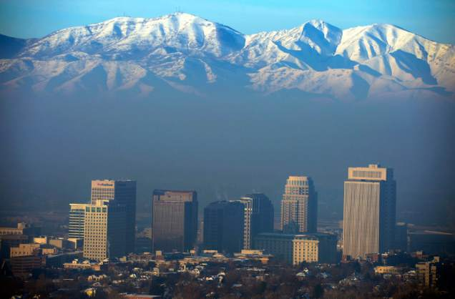
Options for Reducing Wood Smoke
John Ackerly
President, Alliance for Green Heat
Presented to Utah state & county officials
DEQ, 4 Corners Room, 4th Floor
195 N 1950 West
Salt Lake City, UT
February 24, 2015
Notes:
Add AGH logo

Slide 2
Alliance for Green Heat
501c3 nonprofit funded by foundations & grants
A national voice for wood heat consumers
Work for more incentives for the cleanest & most efficient biomass heaters
Call on government to provide R&D funding for ultra-clean “next generation” stoves
Push for more transparency from manufacturers and EPA about testing and efficiencies.
Integrate stoves into work of energy auditors and home energy professionals.

Slide 3

Wood is 3rd most common heat in U.S.

Slide 4
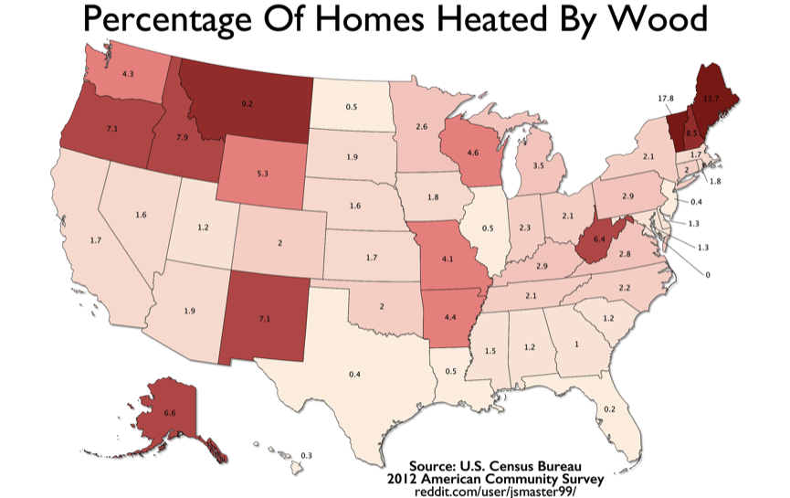

Slide 5
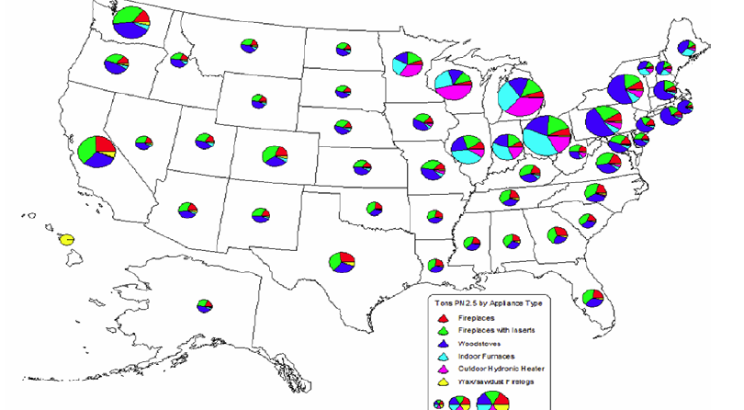
Wood Smoke in the US

Slide 6
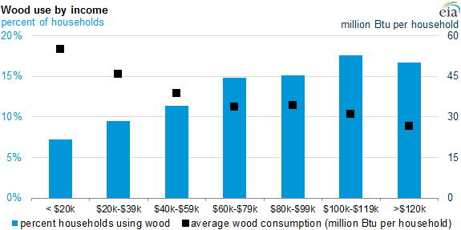
Income & wood heating

Slide 7
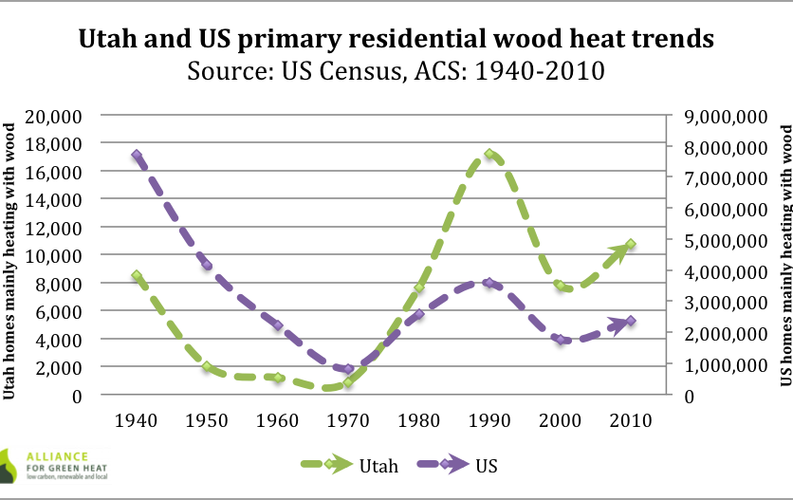

Slide 8
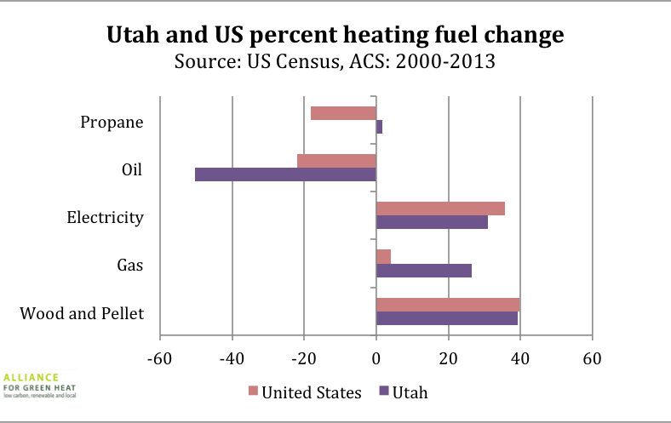

Slide 9
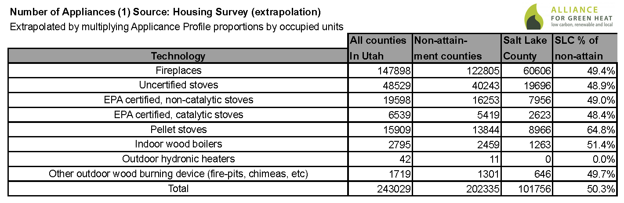
Salt Lake County is ground zero
80% of all fireplaces and stoves in Utah are in the non-attainment area.
Half of all fireplaces and stoves in non-attainment area are in Salt Lake county.

Slide 10
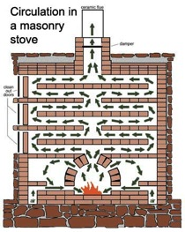
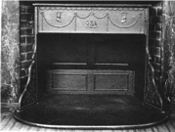
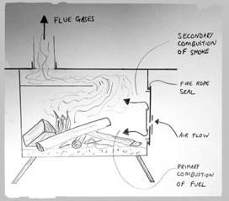
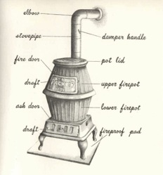
Evolution of Stove Technology
1600s
1744
1970s
1870

Slide 11
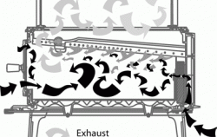
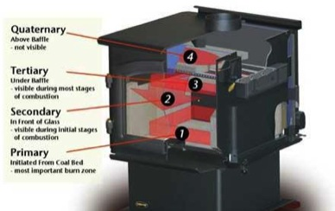
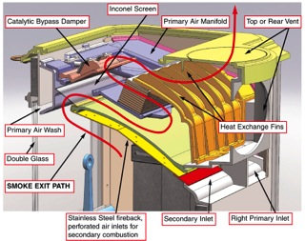
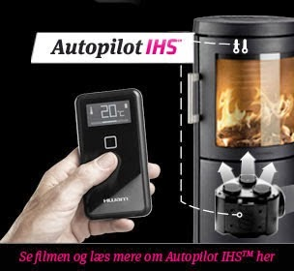
1988 to present
1990
2000
2012
2013

Slide 12
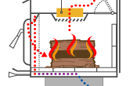
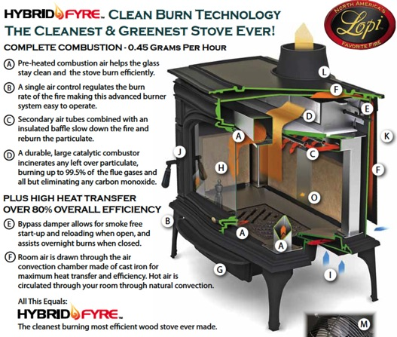
Fall and Rise of Catalytic Stove

Slide 13
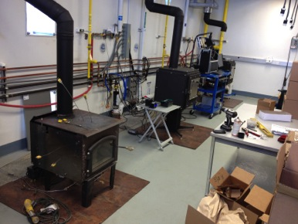
EPA Testing: Lab vs. Real World
EPA uses crib wood (2x4s, 4x4s) not cord wood
EPA uses dry wood
EPA starts test when stove is hot. Thus, the
EPA does not capture emissions during start-up and reloading, the dirtiest part of the burn
Highly skilled technicians
operate the stove for testing

Slide 14
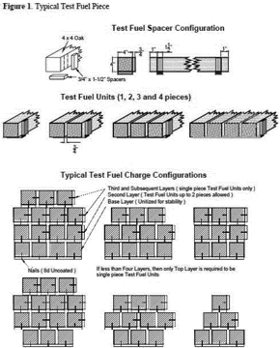
EPA Stove Testing
The test process is about $6,000 for pellet stoves and $10,000 and higher for wood stoves.
Stoves are tested at 4 burn rates – with
air on lowest setting, medium low,
medium high and highest setting. Those
numbers are then averaged and average
has to be under 4.5.
Lowest setting is almost always hardest.
Cordwood will probably be required in
Next NSPS.

Slide 15
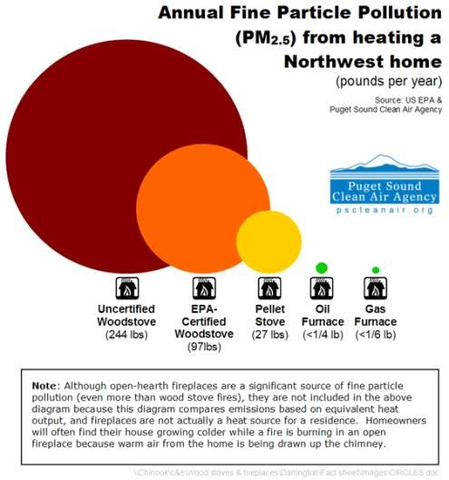
Example of lab vs. real world emissions
Certified by EPA lab at 4 grams an hour
Consumer average may be around 6 – 12 g/hr
Lab tests
* Low burn: avg. of 8 gr/h
Medium low: 5
Medium high 2.5
High: 1
Real world could be
15 gr/h low burn
12 medium low
10 medium high
8 high

Slide 16
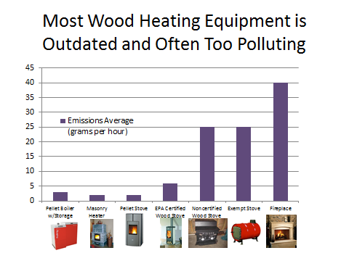

Slide 17
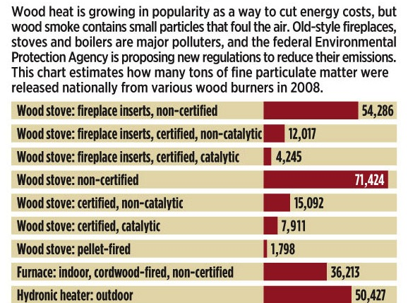

Slide 18
1 Wood stove = 10 pellet stoves
1 wood stove can emit same PM as 10 pellet stoves.
Poorly operated EPA certified stove often emit same emissions as well operated uncertified stoves.
Most pellet stoves put out 1 – 2 grams an hour.
Pellet stoves rarely put out any visible smoke and can be vented like a dryer out side of house.
Pellet stove: Lab results are often similar to real world emissions, if stove is kept relatively clean.
Many EPA certified wood stoves average around 10 grams an hour, if they are operated relatively well.

Slide 19
New EPA Regulations
Changes as of 2020:
  Emission standards for stoves to drop from 4.5 to 2.0 in 2020
  In coming years, more stoves will be tested with cordwood
  Prices should not change in next few years
Changes as of 2015/2016:
  Pellet stoves will have to be certified
  Exempt wood stoves will come off the market
  Actual, verified efficiencies will start to be posted

Slide 20
Options to reduce wood smoke
Step 1 – less difficult & expensive
Education, education, education, education
Ban installation of uncertified stoves
Require permits & inspections to install stoves
Only allow pellet stoves under 1.5 g/hr to be installed & wood stoves under 2.5 or 3 gr/hr
Bounty or buy back program
Moratorium on the installation of fireplaces & wood stoves
Or, moratorium on installs where homes have gas access
Include stoves in energy audits & engage chimney sweeps
Step 2 – more difficult & expensive
Sunset clauses in populated counties/areas
Change out: old wood to new gas or pellet only
Upon sale of home, dispose of old stoves
Cap & Trade

Slide 21
Strategies
Engage more agencies and more experts
  Building permit office
  Energy auditors & chimney sweeps
  Insurance companies
  LIHEAP agencies
  Divide & Conquer
  * Target counties where most wood smoke originates
  Target areas that have most access to natural gas
  Rural, sparsely population areas without natural gas should not be targeted

Slide 22

Education, education, education
Messaging:
  Don’t waste your wood. Smoke is unburned wood with lots of BTUs in it.
  Second hand smoke especially bad for your kids and elderly.
Themes: technology, fuel, operation
  Benefits of pellet stoves (they can save you more money)
  Benefits of dry wood (saves money; better for health)
  Benefits of wood bricks (can save money; easier to store)

Slide 23
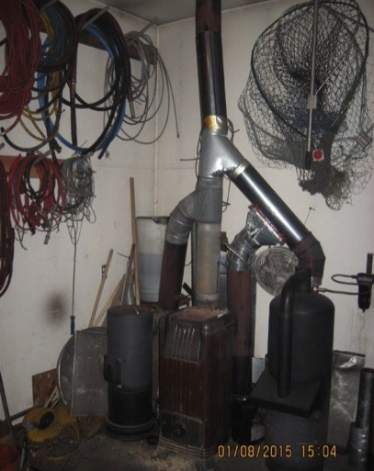
Education: Insurance matters
Insurance companies may refuse to pay if stove was not permitted and/or inspected
Home owners should inform their insurance company.
Sometimes rates increase up to $40-$60 extra per year.
Some insurance companies see freestanding wood stoves as a greater risk than inserts.
Companies often want evidence stove was professionally installed or inspected.

Slide 24
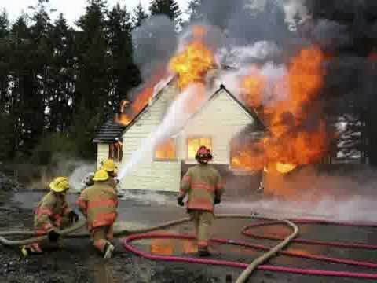
Education: stoves can be dangerous
Wood stoves cause 4,000 house fires each year
Over one-quarter of residential building heating fires result from improper maintenance of heating equipment, specifically the failure to clean the equipment.
Agencies should strongly recommend sweeps certified by the Chimney Safety institute of America (CSIA)
Chimneys should be cleaned
annually by a certified sweep

Slide 25
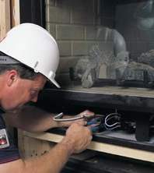
Require permits & inspections
Thousands of towns and counties and at least 4 states (MA, OR, WA & WI) require permits to install wood stoves
Permitted stove installations usually also requires inspection from a certified mechanical inspector.
Results in cleaner & safer installs
Prevents installs of uncertified stoves
In Utah, Manila and West Valley City require permits

Slide 26
Ban install of old stoves
In non-attainment area, or in certain counties, only allow install of certified wood stoves and pellet stoves.
Still allows for healthy second hand trade in certified stoves (made since 1990).
Requires some enforcement & lots of education
Enables airsheds to preserve air quality gains and not backslide
Can require monitoring of craigslist and other second hand outlets.

Slide 27
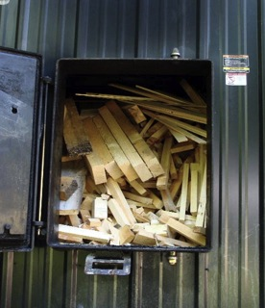

Ban install of outdoor & indoor boilers
In non-attainment area, or at very least in populated counties, even new, certified outdoor wood boilers pose a major air quality threat.
Indoor boilers won’t even be regulated until 2017 and should not be allowed to be installed
between now and then.

Slide 28
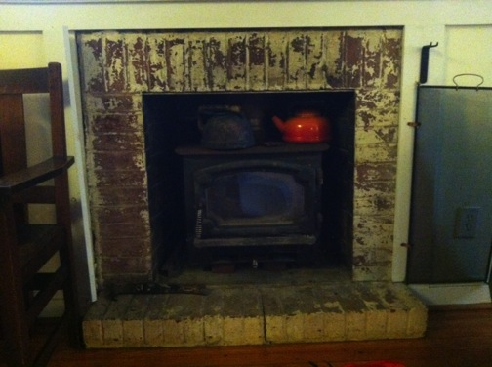
Only allow install of cleaner stoves
Only allow wood stoves under 2.5 or 3.0 g/hr
Only allow pellet stoves under 1.5 or 2.0 g/hr
Only allow EPA qualified fireplaces?
Many states have
incentive & change out
programs with stricter
emission limits
Washington & Oregon
have long done this.

Slide 29
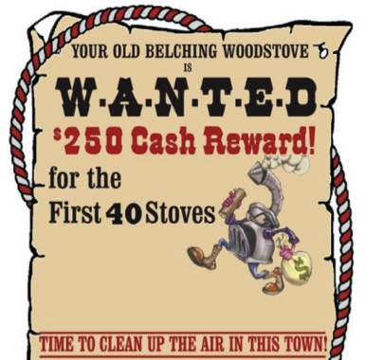
Buyback or Bounty Programs
Pay a “bounty” for people who turn in old wood stoves.
Bounty programs do not involve the purchase of a new stove or appliance.
Examples:
  Allegany County, PA :
    Sponsored by County Health Department in 2013
    $500 gift cards per old OWB
    $200 gift card per old stove
  Methow Valley, WA:
    Sponsored by state DOE in 2012
    $250 per old wood stove
    69 stoves collected and destroyed

Slide 30
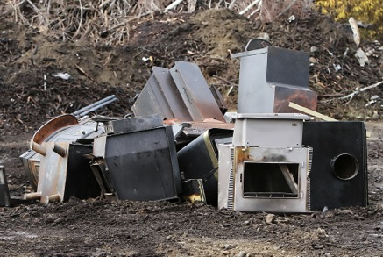
Buyback logistics
Responsibility of homeowner to deliver stove
Need drop off site, ideally a steel recycler
Can give gift card or rebate check on spot
No questions asked; stove may not have been in use much, or at all.
$250 - $350 is far, far
cheaper than change-out
which often costs $700-
$1,000 & far more
bureaucracy

Slide 31
Moratorium on sales/installs
A 4 – 6 moratorium on wood stoves & fireplaces installs buys time to plan and educate people
A moratorium should not cover pellet stoves
Retailers can still sell gas, pellet and other equipment.
Timing is key. If moratorium covers entire fall & winter, it will be tougher sell.

Slide 32
Include stoves in energy audits
Energy audits educate homeowners & lead to voluntary change outs
Auditors find many unsafe installs and often are working with homeowners ready to make efficiency improvements.
Building Professional Institute (BPI) now has stove inspection standards that Utah may be able to require for any subsidized audits

Slide 33
Logistics: stoves in energy audits
1. Physical inspection of stove
  EPA certification
  Safety listing (UL, etc.)
  Structural integrity & rust
  Glass & gaskets
  Fire brick
2. Inspection of clearances
3. Inspection of evidence of smoke leakage
4. Inspection of fuel and fuel storage
5. Inspection of visible creosote on chimney

Slide 34
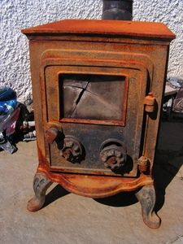
LIHEAP designation of wood stoves as a “Health and Safety hazard”?
LIHEAP funds can be used to replace wood stoves
Not certified by the EPA?
No UL listing?
Cracked firebox?
Insufficient clearances?
Low income homes using an old stove as a primary heating unit may be eligible for assistance to get a new, clean, high efficiency stove

Slide 35
Enforcing existing regulations
R156-55a-301. License Classifications - Scope of Practice.
(2) Licenses shall be issued in the following primary classifications and subclassifications:
S430 - Metal Firebox and Fuel Burning Stove Installer. Fabrication, construction, and installation of metal fireboxes, fireplaces, and wood or coal-burning stoves, including the installation of venting and exhaust systems, provided the individual performing the installation is RMGA certified.
http://www.rules.utah.gov/publicat/code/r156/r156-55a.htm

Slide 36
Step 2 tactics
More resource intensive: $ and time
Potentially more intrusive
May work better at county level than in all of non-attainment area

Slide 37
State tax credit: positive reinforcement
Offer a $500 - $750 state tax credit for pellet stoves under 1.5 or 2 grams/hr.
Drives sales toward pellet stoves
Highlights benefits of pellet stoves and helps educate people
Shows that the state supports selected wood heating appliances
Does not have to require trade in of old stove
Could limit it to rural households that do not have access to gas

Slide 38
Sunset clause
Example: as of Jan. 1, 2018, no one can operate an uncertified wood stove.
Up to Dec. 31, 2017, old, uncertified wood stoves can be dropped off for $350 rebate; new pellet stoves eligible for $500 tax credit.
Vermont set sunset law for outdoor wood boilers, coupled with buyback or change-out funding.
Puget Sound Air Quality Agency is fining anyone with an uncertified stove after August 2015. Announced plan in 2012. http://www.airsafepiercecounty.org/wood-stove-rule

Slide 39
Change out program options
Likely has greatest acceptance by public and hearth industry as these are typically voluntary.
Rebates to swap out old wood stove for new gas or pellet stove.
Could offer new wood stove in rural areas without access to gas.
Scores of jurisdictions have done these with wide range of results.
Libby MT often cited as a success, but was very expensive and in a small, contained valley.

Slide 40
Change out considerations
Should be coupled with laws banning installs of old stoves
Rebate gives leverage to require professional installation and stricter emission limits
Should be done in conjunction with buy back program
Can be done in conjunction with sunset clause
To minimize costs, option of buying value stoves from big box hardware stores can be emphasized

Slide 41
Value Stove & Installation Costs
Pellet stove - Englander
Wood stove - Englander
 | Small: 1,200 sq. ft. | Medium: 1,500 - 1,800 sq. ft. | Large: 2,000 -2,200 sq. ft.
Wood stove | $550 | $650 | $900
Installation, materials | $500 | $500 | $500
Hearth pad (Type II) | $65 | $85 | $85
Installation, labor | $800 | $1,000 | $1,000
Total | $1,915 | $2,235 | $2,485
 |  | Medium: 1,500 - 1,800 sq. ft. | Large: 2,000 -2,200 sq. ft.
Pellet stove |  | $1,100 | $1,550
Installation Kit |  | $230 | $230
Hearth pad (Type II) |  | $45 | $55
Installation, labor |  | $700 | $800
Total |  | $2,075 | $2,635

Slide 42
Libby MT Change out results

Slide 43
Removal upon sale of home
Oregon requires that
an uncertified stove be
removed and destroyed
upon sale of home.
Burden is on real estate
brokers and homeowners.

Slide 44
Requiring Destruction of Old Stove Upon Sale of Home
NH Bill Summary: All wood stoves made before 1986 and not EPA certified by shall be removed and destroyed upon the sale of a home if the home is in a densely populated area.
The seller who is responsible for the removal and destruction shall provide proof of destruction.
This NH bill did not pass
Exempt:
(a) Antique stoves: built before 1940 with ornate construction
(b) An indoor, wood-fired furnace that is thermostatically controlled, has a dedicated cold air inlet and connected to heating ductwork
(c) A masonry heater: site-built or site-assembled, solid fueled heating device constructed to store heat
http://www.gencourt.state.nh.us/legislation/2013/HB0307.html4

Slide 45
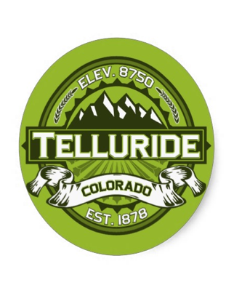
Cap & trade in Telluride, CO
In 1985, Telluride, Colorado required all wood burning stoves to be registered with the town.
Town set cap of 545 wood stove permits allowed to sold among residents. Market price for permits was $1,500 each in 1991
Park City or Summit County considering this.

Slide 46
Emission standards in 2015 EPA Residential Heater Regulations
Technology | Step 1: 2015-20 | Step 2: 2020-23? | 1988 - 2015
Wood stove – crib | 4.5 | 2 | 7.5
Wood stove – cordwood | 4.5 | 2.5
Pellet stove | 4.5 | 2
Boilers | 0.32 | 0.1
Warm air furnaces | 0.93 | 0.15

Slide 47
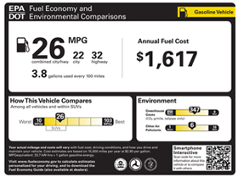
Consumer Labels in New Rules
Stoves that test with cordwood in next 5 years, and can meet 4.5 grams an hour, can use a special EPA approved label to alert consumers that stove is designed and tested as it will be used by consumer.
Stoves that meet Step 2, 2020 emission limit of 2 grams an hour (or 2.5 with cordwood) can also use a special label alerting consumers that they meet strictest standards.
These are good steps but if EPA and
Industry don’t make these work,
a more comprehensive “green label”
may be needed.

Slide 48
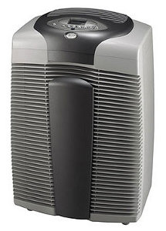
Indoor air issues
Inversions especially make wood smoke a neighborhood public health
Smoke re-enters homes through any crack, or from forced air systems with outside air intake
Poor draft or negative pressure can cause fugitive indoor emissions
Old stove with cracks, old gaskets, etc. can leak
Any ongoing detectable smell of smoke needs addressing
$300 HEPA air filter can reduce indoor PM2.5 issues
With liquid fuels, danger is CO. With solid
fuels its PM.

Slide 49
Efficiency in New EPA Rules
Manufacturers have to start testing and publicly reporting efficiency using B415 & HHV.
Manufacturers have to disclose efficiency when stoves are tested for certification, or recertification.
Most stoves don’t have to be retested for years, so efficiency numbers likely to come out very slowly.
Manufacturers can voluntarily submit efficiency numbers at any time. (Industry is not encouraging this.)
The estimated default efficiencies (63, 72 and 78) will be phased out soon.
Efficiency measured by a “stack-loss” measurement

Slide 50
Efficiency of wood appliances
As tested at High Heating Value (HHV)

Slide 51
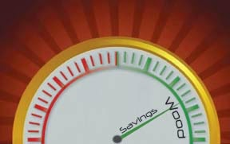
Best heating fuel calculators
The Alliance for Green Heat reviewed scores of the most popular fuel calculators and found many of them to be hard to use and biased.
Of the dozens of calculators we reviewed, we recommend two:
  USDA Forest Service calculator
  Hearth.com calculator
Our recommendations for heating fuel calculator efficiencies reflect values of a new appliance when it is being used with seasoned wood:
EPA certified non-cat stove: 70%
EPA certified cat stove: 75%
EPA certified pellet stove: 78%
Exempt/uncertified wood stove: 54%
Exempt pellet stove: 65%
EPA Phase 2 outdoor boiler: 65%
Exempt outdoor boiler: 45%
EN 303-5 pellet boiler: 80%

Slide 52
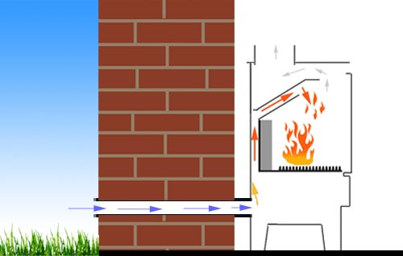
Efficiency, draw and Dedicated outside air (DOA)
CFM in stoves range from 4 – 22. Avg. of 10-15
The chimney is the engine of every stove wood stove (not with pellet stoves).
The Outdoor Air Myth Exposed - Woodheat.org
A high efficiency stove (80-83%) may have only 200 degree exhaust temp.
Most houses do not need
DOA but more and more tight
ones do.
WA state requires DOA.

Slide 53
What consumers need to know: Wood Stoves
Efficiency: If efficiency is a real priority and the stove will be a primary heater, consider a catalytic stove. Catalytic stoves got a deserved bad rap in 80s and 90s but designs are far better today. Woodstock Soapstone, Blaze King and Travis make great catalytic stoves and report B415 efficiency numbers. They all make stoves that are over 80% HHV efficiency (90% LHV). Non-cats are 10 – 20% less efficient.
Emissions: Key to low emissions is using dry, split wood, not the grams per hour as tested in the lab.
Sizing is key: Make sure stove is sized to the space it can effectively heat.
Professional installation: Find a pro certified by the National Fireplace Institute (NFI), http://nficertified.org.

Slide 54
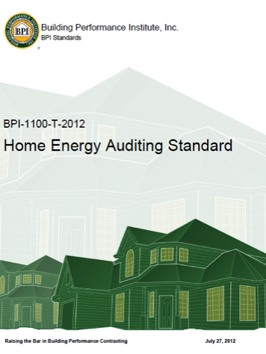
Wood stoves in BPI standards
The Home Energy
Auditing Standard
(BPI-1100-T-2012):
  7.8: Energy auditors shall Inspect solid fuel burning appliances for safe operation and efficiency.
  7.23: Energy auditors shall recommend replacement of solid fuel burning appliances with listed and EPA-certified appliances if the existing appliance is not safety listed or has signs of structural failure.

Slide 55
BPI Homeowner Questionnaire
10. Do you have a working fireplace, woodstove or pellet stove
  A. How often do you use it?
  How often is the flue cleaned?
  How often is the fireplace, woodstove or pellet stove cleaned?
  11. What type of fuel is being used?
  Where do you store the wood or pellets?
  How much fuel did you use during the last heating season?
  Are there issues such as excessive smoking or staining when the fireplaces, woodstove or pellet stove is in use?
  12. Do you have the owners manual or installation guide for the appliance

Slide 56
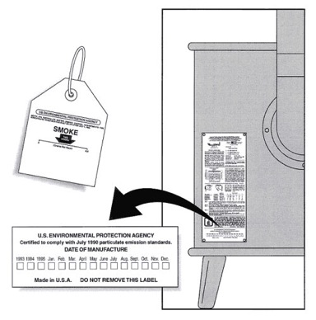
EPA certification and UL listing
Make sure to check
Back of stove for EPA and UL label.
If brand and model are on EPA certified list.
Year purchased. Before 1988, not certified. After 1988, probably certified.
For glass door. If it has one, it’s likely certified.
Note: Pellet stoves do not require EPA certification.

Slide 57
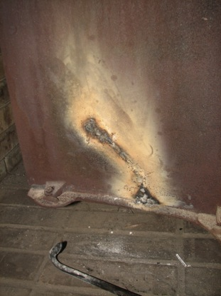
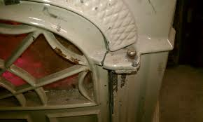
Signs of structural failure
Cracks and rust in the body
Cracks in the door and glass

Slide 58
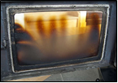
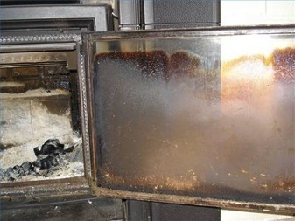
Glass
Dirty glass is a sign the stove owner is not operating stove correctly or the stove is inefficient.
Recommend the homeowner clean the glass every day to see how quickly it gets dirty. If it gets dirty in a single day, the combustion is poor.
Cracked glass should be replaced.

Slide 59
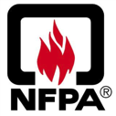
Clearances from combustibles
These are very general guidelines and do not reflect legal requirements.
Inspect area for combustibles within 12 inches of stove (includes dry wall)
Old, uncertified stoves usually require 18 – 24 inches from combustible.
EPA certified stove usually require no less than 12 inches.
Minimum clearances are printed in the stove manual. If manual cannot be found, follow NFPA guidelines.
NFPA Recommended Clearances
 | Radiant Stove | Stove Pipe
Ceiling | 36” | 18”
Front | 36” | 18”
Side | 36” | 18”
Rear | 36” | 18”
Floor | 18” | 18”

Slide 60
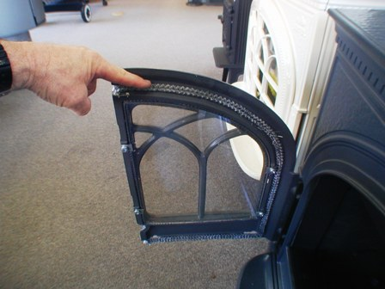
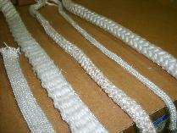
Inspecting gaskets
Missing or degraded gaskets could lead to smoke and CO entering the house.
If the gasket around the stove door is loose, missing or degraded, recommend owner gets a replacement.
Gasket rope comes in different sizes, so tell the homeowner to consult owner’s manual before buying.

Slide 61
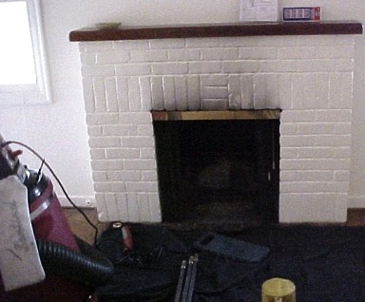
Smoke leakage
Check the interior of the home for signs of smoke leakage, especially the fireplace and mantle in the case of wood stove inserts.
A leaky stove is a health and safety hazard and should be replaced.

Slide 62
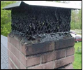
Chimneys
Chimneys collect creosote (tar), the leading cause of chimney fires, and should be inspected once a year.
Check for creosote by looking up the chimney with a strong flashlight. Creosote can be visible on the grate of the chimney cap as well.
BPI, Technical Standards for the Heating Professional says: “A deteriorated chimney must be repaired or relined and the cause corrected before reusing.”

Slide 63
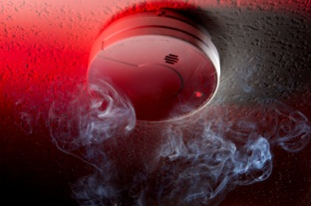
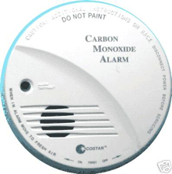
Smoke & carbon dioxide monitors
Check if home has an operational smoke detector and carbon monoxide monitor and test them.
Smoke alarms should be on a ceiling or high on a wall. Carbon monoxide alarms should also be placed at least 5 feet high, but not directly above or beside wood stoves, since they may emit a small amount of CO upon start-up.

Slide 64
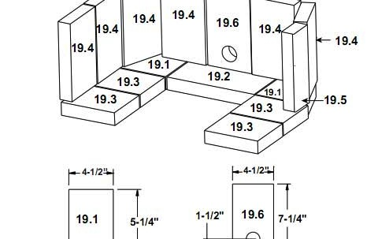
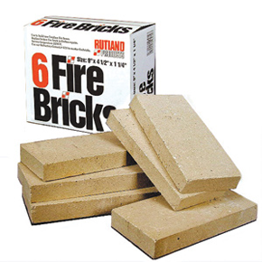
Firebrick
Firebrick is essential to maintaining a hot fire. Hard to get hot enough combustion to certify a stove with EPA without firebrick.
Cracks are OK, but once it crumbles or is removed for whatever reason by homeowner, it needs to be replaced.
Many stove brands use same size firebrick but you have to measure it and make sure first.

Slide 65


Firewood
Inspect fuel storage to see if wood is split, stacked and covered. Splitting and stacking is essential; covering is best.
Inspect wood to check if it is seasoned. Ideal is to test with moisture meter and show homeowner. Make sure you split wood and know how to use your meter.
Seasoned wood is 20% or less moisture. Unseasoned wood leads to inefficient, smoky fires.

Slide 66




Pressed wood bricks
Types: Blocks, bricks, and logs
Typical materials: sawdust, wood shavings, and wood chips
Typical cost per ton: $280-$300
Typical size/weight (block): 2.5 x 4 x 6 in., 2-3 lbs.
Currently ~13 different brands and ~20 different products sold in the Northeast region

Slide 67


Installation & repair certification
National Fireplace Institute (NFI)
  Non-profit certification agency that trains, tests and certifies hearth professionals, mostly focusing on installation of new units.
Chimney Safety Institute of America (CSIA)
  Focuses on chimneys but includes some hearth installation training.

Slide 68

The Wood Stove Checklist
Written by Alliance for Green with support from the University of Maryland Extension as a tool for home energy auditors and others to help assess wood stove safety and efficiency
Available through the Extension website: http://www.naturalresources.umd.edu/Publications/FactSheets/FS-936_2012_Wood_Stove_Checklist.pdf
Send any feedback to contact@forgreenheat.org

Slide 69

Thank you!
John Ackerly
www.forgreenheat.org
john@forgreenheat.org
301-841-7755

